Slide 1

Programming Concepts
Introduction Part 2

Slide 2
What is an Integrated Development Environment (IDE)?

Slide 3
What is an IDE?
An application using which a developer can develop & test programs
Most are dedicated to some/a subset of programming languages
Usually includes:
A source code editor
Tools to “build” the code
Debugging Tools

Slide 4
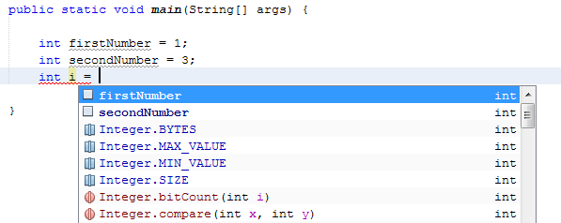
IDEs
Might include:
Intelligent code completion
Designer to build GUIs with simple drag-and-drop
Most popular are:
NetBeans
Eclipse
Microsoft Visual Studio
Notes:
The NetBeans IDE is primarily intended for development in Java, but also supports other languages, in particular PHP, C/C++ and HTML5. Others for java are blueJ, Jdeveloper, Jcreator

Slide 5
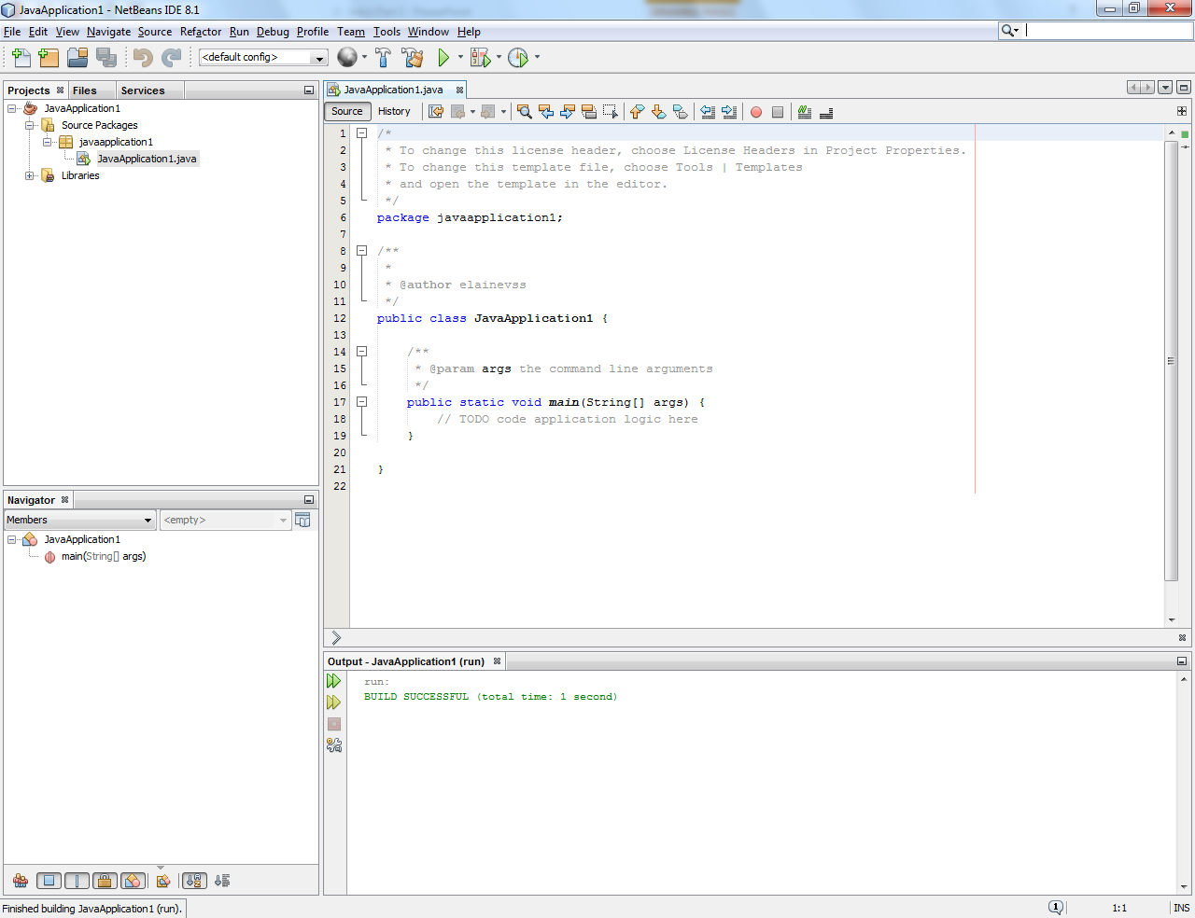
NetBeans
Project Panel
Editor/Designer
Building, Debugging and Output

Slide 6
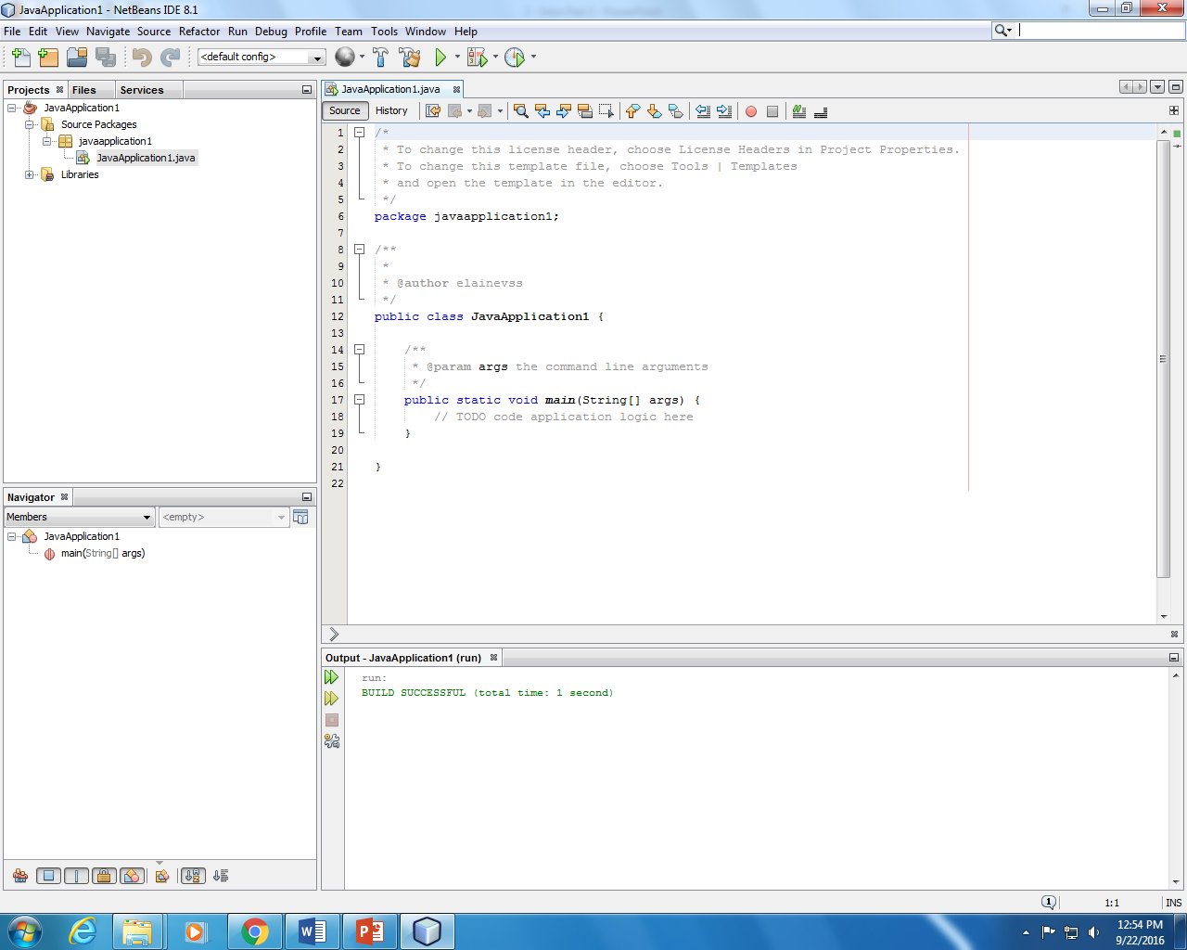
Project Panel
The Project Panel displays the currently open project or projects (in this case called JavaApplication1), the “folders” inside the project (called packages) and the files inside the folders.
From this panel it is possible to open files, such as JavaApplication1.java for editing, and add new files to a project.

Slide 7
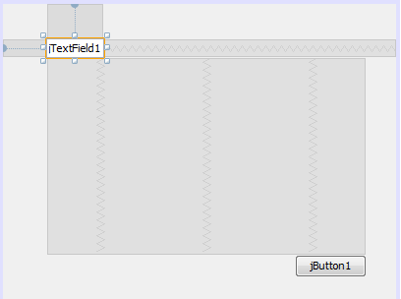
Editor \ Designer
Editors and designers usually have two views: a graphical design view and the code behind view or source view.
Design view lets you drag controls from the toolbox and drop them on the design surface, whilst in the source view it is possible to write the code. The main advantage is that they highlight the syntax and autocomplete the syntax.

Slide 8
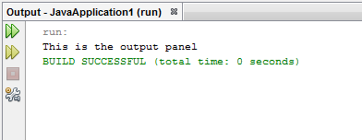
Building, Debugging, Output
Building the application helps detect compile-time errors such syntax errors, misspelled keywords, and type mismatches. The Output Window shown above displays these types of errors.
Also, the output window shows the output of the program (in the case of console applications).
Notes:
Run= build and debug
Build= Source code to executable code
Debug= find errors

Slide 9
What are programming paradigms?

Slide 10
What are programming paradigms?
A way or style of programming
We usually think about programming as a sequence of instructions
But this is not the only way!
Different styles have evolved over time…

Slide 11
Programming paradigms
Procedural/Structured
Object-Oriented
Declarative
Functional
Event-Driven

Slide 12
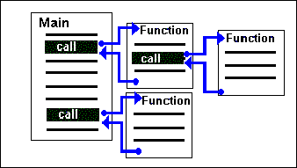
Procedural/Structured Programming
Quite simple
Based on a sequence of instructions
May be grouped into procedures which can then be called
E.g. Java, Python, C#
Advantages
Easy to understand, use
and test

Slide 13
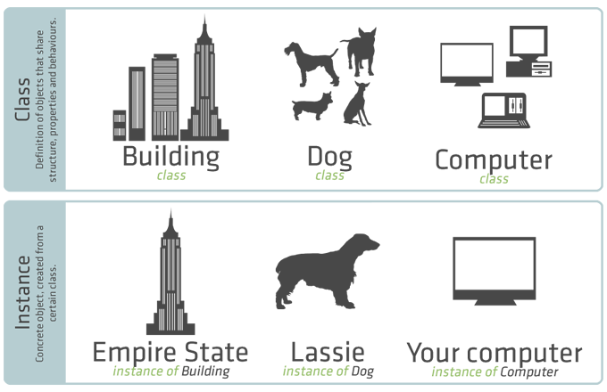
Object Oriented Programming
Known as OOP
Similar to the world around us
Methods and data are kept inside objects
Different objects can communicate
E.g. Java, C#
Advantages
Allows reusability of code

Slide 14
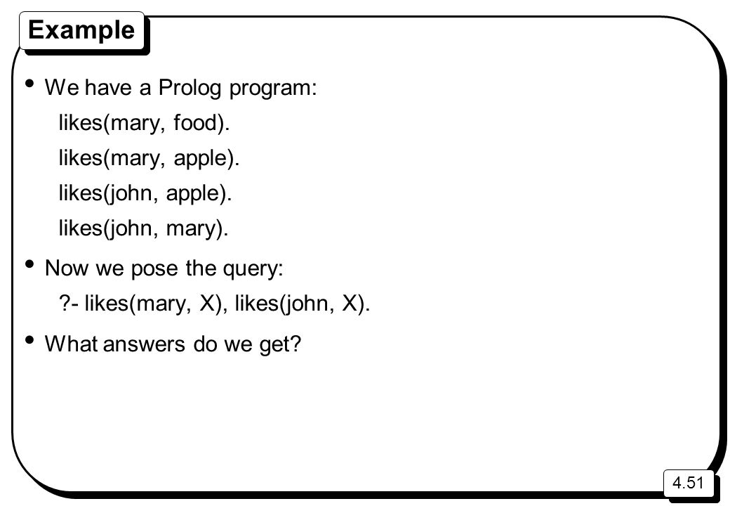
Declarative Programming
Expresses logic only
Without control flow
E.g. Prolog, SQL
Advantages
Shorter code
Easy to use

Slide 15
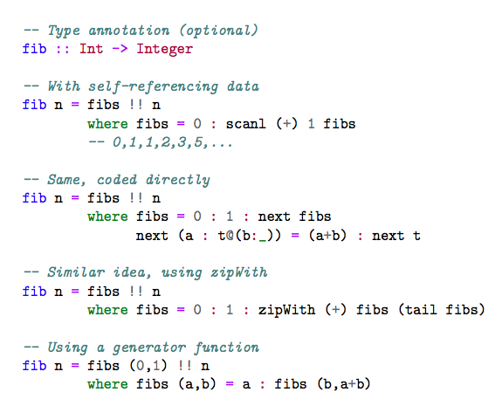
Functional Programming
Program simply evaluates mathematical functions
Code is shorter…to be less error-prone
E.g. C++, Haskell
Advantages
Can reuse sub-programs
Easy syntax
Can focus on math

Slide 16
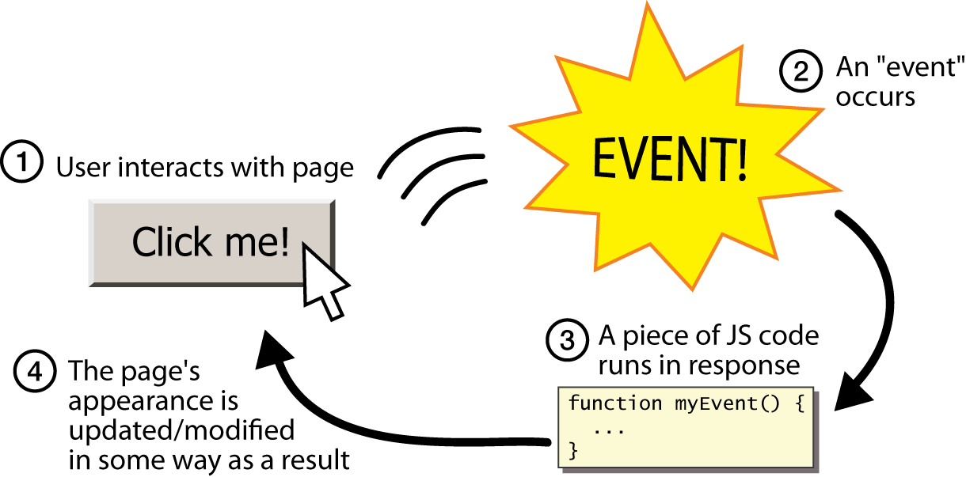
Event-driven Programming
Program flow is determined by events
E.g. Java, C#, JavaScript, ActionScript
Advantages
Suitable for GUI

Slide 17
Programming paradigms
Some languages fall under one paradigm
Others fall under multiple paradigms
A language designed to allow programming in many paradigms is called a multi-paradigm language

Slide 18

Questions

